Slide 1
Projection of Solids

Slide 2

Steps to get projection of solids
Identify the possible cases
Assume initial position
Consider Axis inclination
Consider edge inclination

Slide 3
Assume initial position
Surface inclined to HP
Surface inclined to VP

Slide 4
Assume initial position
Axis inclined to HP
Axis inclined to VP

Slide 5
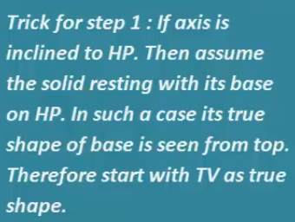
Assume initial position
Axis inclined to HP
That entity should be resting on HP
VP
HP

Slide 6
Some other conditions

Slide 7
Q1. Regular pentagonal prism of 25 mm and axis 50 mm long resting on one of its rectangular faces on the HP with the axis inclined at 45° to the VP. Draw the projections.
φ_{axis}=45°
1'
5'
e’
a'
d'
4'
b'
VP (FV)
2'
c'
Y
3'
X
10
5
1
4
2
3
45°
3
2
HP (TV)
4
1
50
5
c
e
a
d
b
c
b
d
a
e

Slide 8
1'
5'
4’
d'
e’
a'
3’
d'
5’
e'
c'
4'
b'
2'
c'
Y
3'
1’
2’
a'
b'
X
10
5
1
4
2
3
45°
3
2
4
1
50
5
c
e
a
d
b
c
b
d
a
e

